Slide 1
Directions for this Template
Use the Slide Master to make universal changes to the presentation, including inserting your organization’s logo
“View” tab > “Slide Master”
Replace placeholders (indicated by brackets [ ]) with information specific to your exercise
Delete any slides that are not relevant for your exercise
Font size should not be smaller than 22pt
Rev. April 2013
HSEEP-C08
Notes:
Organizations can modify and augment this briefing as needed.

Slide 2
Measles Self-Administered Tabletop Exercise
Exercise Briefing
[Date]

Slide 3
Welcome and Overview
[Name]
[Title (e.g., Exercise Director or Lead Planner)]
[Organization]
Administrative Items/Safety
Exits
Restrooms
Rally Point
Cell Phones
Notes:
Go around the room and have everyone introduce themselves

Slide 4
Operational Security
This briefing contains exercise and operational material that must be safeguarded.
The materials in this briefing are categorized as For Official Use Only.

Slide 5
Exercise Schedule
Registration [Time]
Welcome and Overview of Objectives [Time]
Module 1: Incident Notification and Transport [Time]
Break [Time]
Module 2: Hospital Management [Time]
Lunch [Time]
Module 3: Patient Monitoring [Time]
Hot Wash [Time]
Closing Comments [Time]

Slide 6
Exercise Overview
Exercise scope:
Exercise Type: Tabletop Exercise
Duration:
Location:
Exercise Parameters:
Mission area(s): Response

Slide 7
Exercise Purpose
[STATE PURPOSE OF THE EXERCISE]

Slide 8
Objectives and Core Capabilities
Objective 1: Discuss procedures, capabilities and readiness of the whole community and recognize and respond to presentations by potential infectious disease patients.
Aligns to
Objective 2: Review and discuss plans, capabilities, and authorities for responding to a high-risk infectious disease emergency.
Aligns to
Objective 3: Examine and demonstrate public notification procedures.
Aligns to
Objective 4: Examine and demonstrate public notification and information sharing procedures to address messaging and coordination with stakeholders.
Aligns to

Slide 9
Participant Roles and Responsibilities
Players: Respond to situation presented based on current plans, policies, and procedures
Facilitators: Provide situation updates and moderate discussions
Evaluators: Observe and document player discussions
Observers: Support players in developing responses, but do not participate in moderated discussion

Slide 10
Exercise Structure
An infectious disease scenario has been selected for today’s exercise
The exercise will consist of three modules:
Module 1: Incident Notification and Transport
Module 2: Hospital Management
Module 3: Patient Monitoring
Each module begins with a multimedia update that summarizes key events occurring within that time period.
After the updates, participants review the situation and engage in a group discussion of appropriate response issues.

Slide 11
Exercise Guidelines
This is an open, low-stress, no-fault environment.
Varying viewpoints, even disagreements, are expected
Base your responses on current plans and capabilities of your organization
Decisions are not precedent setting; consider different approaches and suggest improvements
Issue identification is not as valuable as suggestions and recommended actions that could improve response efforts; problem-solving efforts should be the focus

Slide 12
Assumptions and Artificialities
The exercise is conducted in a no-fault learning environment wherein capabilities, plans, systems, and processes will be evaluated
The exercise scenario is plausible, and events occur as they are presented
All players receive information at the same time
Respond in the same manner as if this were a real incident

Slide 13
Measles Primer
Symptoms
First stage
Fever
Running nose
Redness of the eyes
Cough
Second stage
Blotchy rash appears on the face and spreads to the rest of the body
Small white sport called “Koplik” spots may be seen on the gums and inside of the cheeks

Slide 14
Measles Primer
Prevention
Vaccinating children as soon as possible
Two doses of measles vaccine are recommended for all children
First dose of the vaccine should be given at 12-15 months of age
Second dose should be given before a child enters kindergarten

Slide 15
Measles Primer
Treatment
There is no specific antiviral therapy for measles
Medical care is supportive and to help relieve symptoms and address complications such as bacterial infections.
Severe measles cases among children, should be treated with vitamin A.

Slide 16
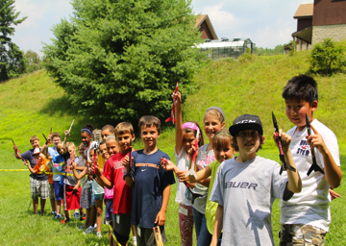
Module 1: Incident Notification and Transport
[Date, Time]
Every summer, John Lopez, an 18-year old student, works at [Christian Science Church/camp for asthmatic children] overnight camp near [Name of Community].
The camp hosts over 300 children ranging in age from 8-15 years old.

Slide 17
Module 1
[Date, Time]
During the last week of camp, John develops a fever and a sore throat. He visits the camp nurse and is diagnosed with the common cold.
A day later, John returns to the camp nurse complaining of achiness. John is sent home from the camp.
John’s sore throat worsens and his eyes begin to become inflamed. His parent’s call 911 and he is transported to the emergency room at [Insert Hospital].

Slide 18
Module 1: Discussion

Slide 19
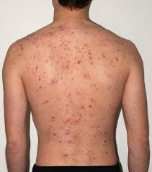
Module 2: Hospital Management
[Date, Time]
After arriving at the hospital small red spots appear on his face along his hairline. After the initial examination the doctor isolates John in an exam room. Suspecting that the cause of illness may be measles the doctor asks for approval from the state lab to test for measles.
The measles test comes back positive. John discloses that he spent the last week around 300 kids at a summer camp in [Insert County].

Slide 20
Module 2: Discussion

Slide 21
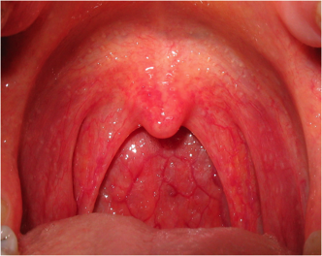
Module 3: Patient Monitoring
[Date, Time]
John is not showing any signs of complication from the measles, and is sent home to get well.
Twenty (20) children who had been at the summer camp and returned home report similar symptoms of a sore throat, cough, achiness, and elevated temperature. Several of these children are sent to hospitals via ambulance.
Five girls go to [Insert Medical Center], six boys and seven girls go to [Insert Medical Center] and two boys go to [Insert Medical Center].

Slide 22
Module 3
[Date, Time]
The measles test confirms that fifteen (15) of the people that sought medical attention have the virus. Many of the children left the summer camp before the confirmation that this was an active case of measles.
Outraged parents of the kids begin posting to social media about the camp’s poor communication regarding the outbreak.
Local news picks up the story and begins reporting daily on the outbreak.

Slide 23
Module 3: Discussion

Slide 24
Hot Wash
Three things that well went during the exercise
Three areas for improvement identified during the exercise
Identify positives and areas for improvement regarding exercise design and delivery

Slide 25
Thank You

